Slide 1
IN DOC DATA ANALYSIS
III (03 Cr. Hrs.)
1620
2016
03-07-2020
Mr.Shoaib Malik
160655 | Muneeb Ur Rehman
160335 | Zaeem Dastagir
Naila Rehman
Dr.Imran Ihsan

Slide 2


Table of Contents
Introduction
Literature Review
Requirement Specifications
Design
Results
Conclusion

Slide 3
INTRODUCTION
Importance of research papers.
Conventional research papers.
Our proposed approach for research papers.

Slide 4
A SOLUTION FOR RESEARCH COMMUNITY
Janiform Documents.
What are Janiform documents ?
Two faced Document.
Valid PDF and HTML(offline) document at same time.

Slide 5
LITERATURE REVIEW
Pre-Existing Systems.
Provoking elements behind our research work.

Slide 6
EXISTING SYSTEMS
R-markdown.(A document editor with integrated language support for R-Language)

Slide 7
PROVOCATING FACTORS
Importance of used data-sets.
Un-availability of raw data.
Irreproducibility of results.

Slide 8
DESIGN (HIGH LEVEL)
LaTeX File
Janiform Compiler
Janiform Document
CALCULATING QUERY RESPONSE TIME
01
02
03
04

Slide 9
DESIGN (LOW LEVEL)
Pre-compiler
Pre-compilation processes are handled here.
e.g. File handling, initial reading of latex file etc.
HTML-compiler
JavaScript libraries are added in this step using pre-compiler class.
Final Stage
Janiform Document produced as an output.

Slide 10
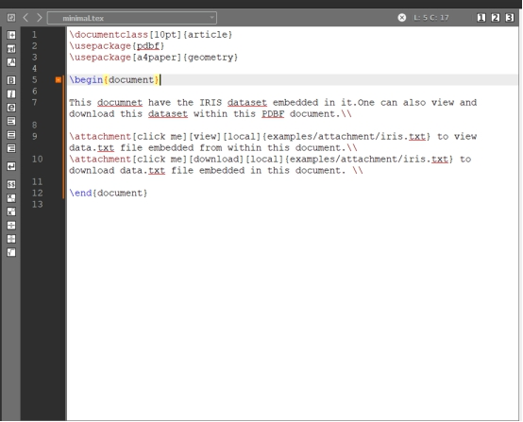
RESULTED DOCUMENT
LaTeX File.

Slide 11
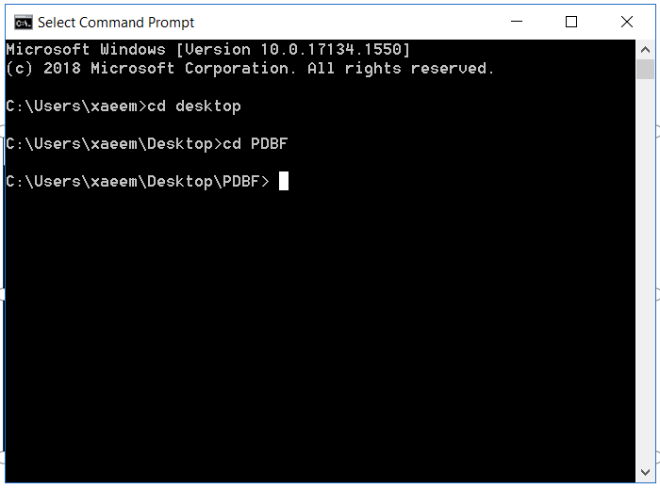
RESULTED DOCUMENT
Calling toolkit via CMD

Slide 12
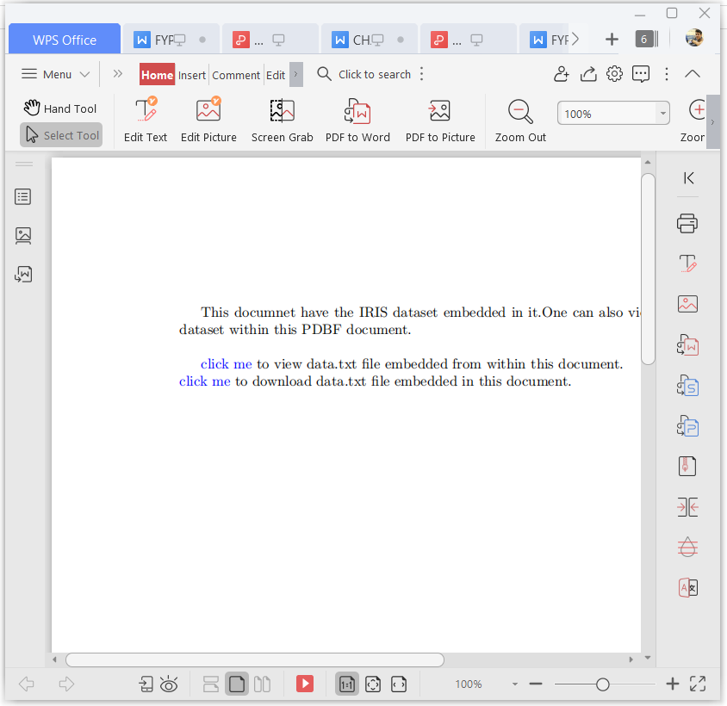
RESULTED DOCUMENT
PDF Version of the document.

Slide 13
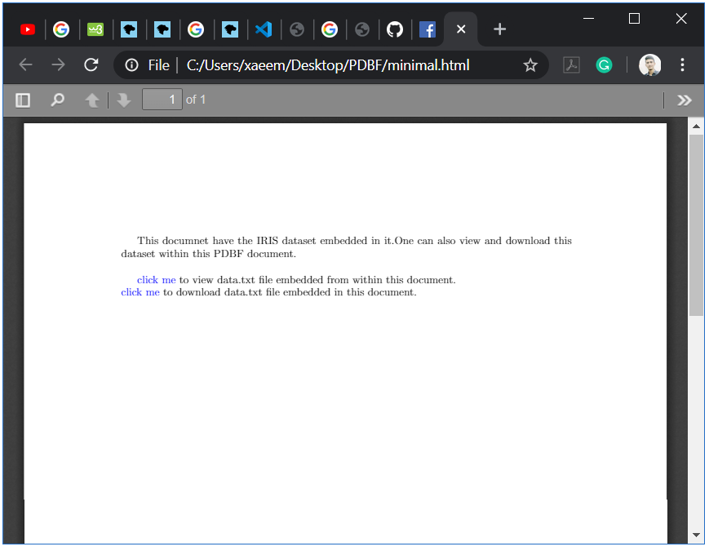
RESULTED DOCUMENT
HTML Version of document.

Slide 14
PRO’S:
Resulting document is janiform.
A valid HTML(offline document) and a pdf document.
Embedded data can be viewed within document and also downloaded.
Data goes where the document goes.

Slide 15
CON’S:
Avoid embedding too large data files.
Problems with latex packages.
Additional time is required for compiling document.

Slide 16
CONCLUSION
Contemporary way of looking at documents.
Wide array of future prospects.
Still have room for new functionalities to be included.

Slide 17


